Slide 1
BASIC OF INFORMATION SECURITY
CHAPTER NO : 01 ( HCSC701: SIM)

Slide 2
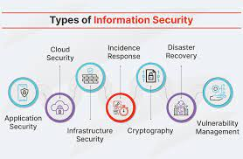
What is Information Security
Information security is the practice of protecting information by mitigating information risks.

Slide 3
Needs of Information security
Information security protects sensitive information from unauthorized activities, including inspection, modification, recording, and any disruption or destruction. The goal is to ensure the safety and privacy of critical data such as customer account details, financial data or intellectual property.

Slide 4
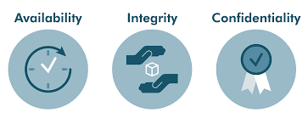

Slide 5
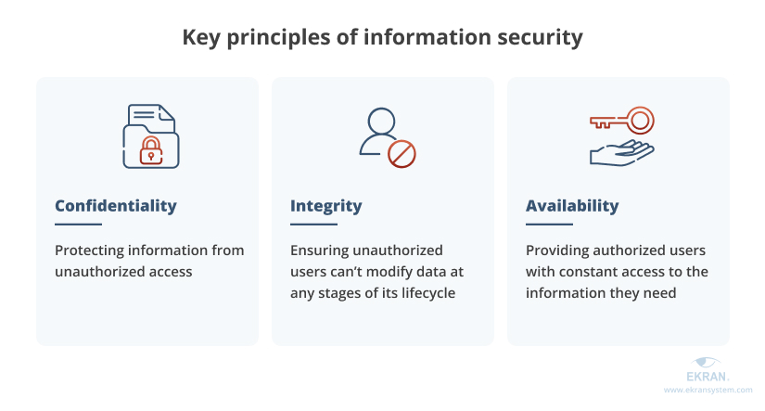

Slide 6
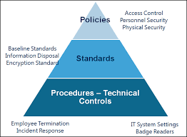

Slide 7
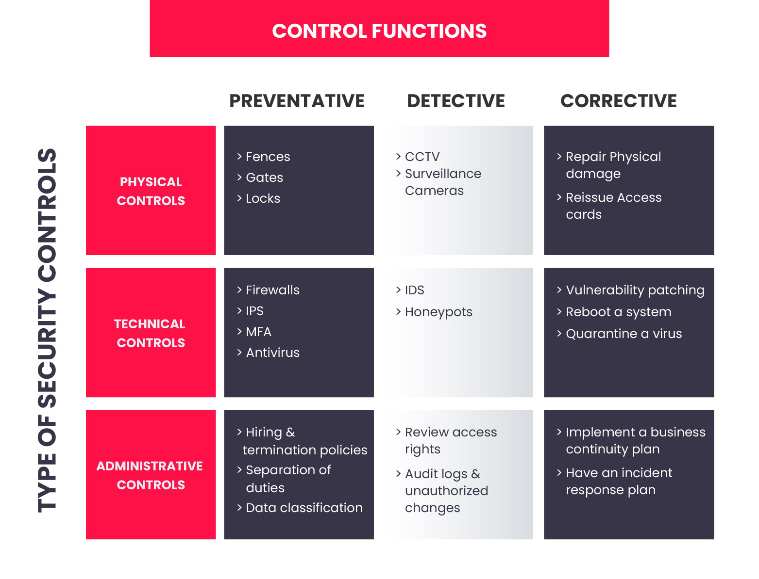

Slide 8
Administrative Control
Administrative Control is a set of security rules, policies, procedures, or guidelines specified by the management to control access and usage of confidential information. It includes all the levels of employees in the organization and determines the privileged access to the resources to access data.
User Management
Privilege Management
Employee Security, Clearance, and Evaluation
Employee training and awareness, etc.

Slide 9
Technical Control
Technical Control is to control the access of confidential information over the network using technology. Technical functions are involved in managing and controlling the access of the employee. Some examples of technical controls are:
Access controls
Firewalls
Network Authentication
Encryption, etc.

Slide 10
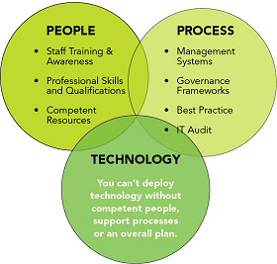

Slide 11
Physical Control
Physical Control is a set of security controls implemented physically to prevent unauthorized access to the data and security risks. Some examples of physical controls are:
Surveillance cameras
Biometrics
Identity Cards
Alarm systems, etc.

Slide 12
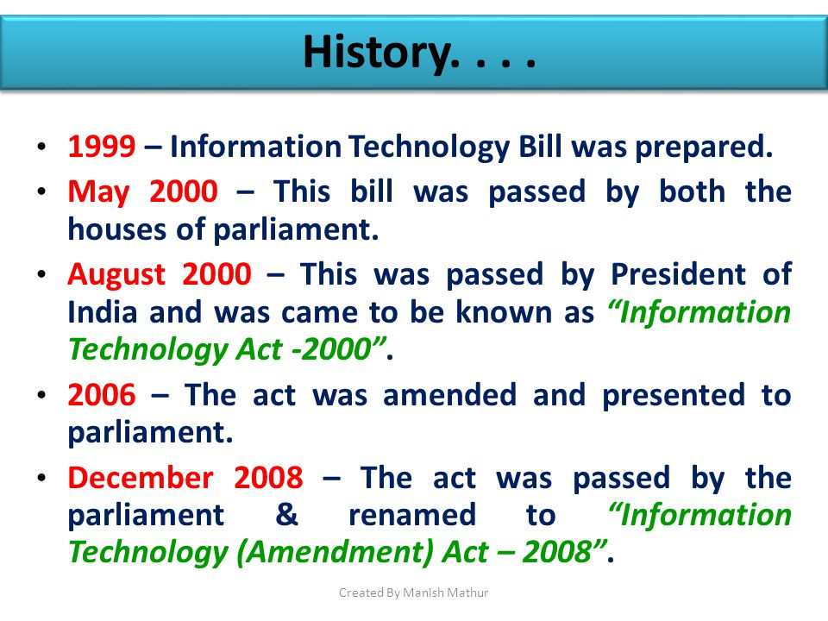

Slide 13
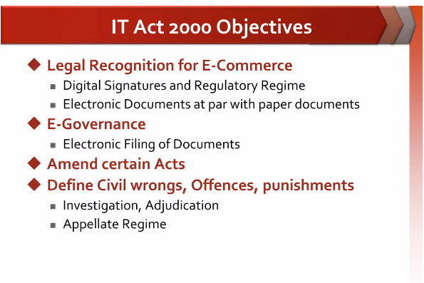

Slide 14
